Slide 1
Computer Science

Slide 2
Why Computer Science
Computer Scientist
Data Analyst
Data Engineer
Business Analyst
Data Architect
Web Developer
Web Designer
Software Developer
…

Slide 3
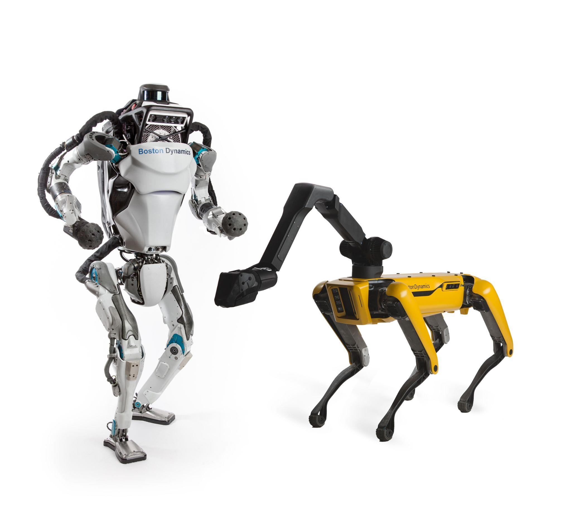

Slide 4


Slide 5


Slide 6



Slide 7


Slide 8
Why Python

Slide 9
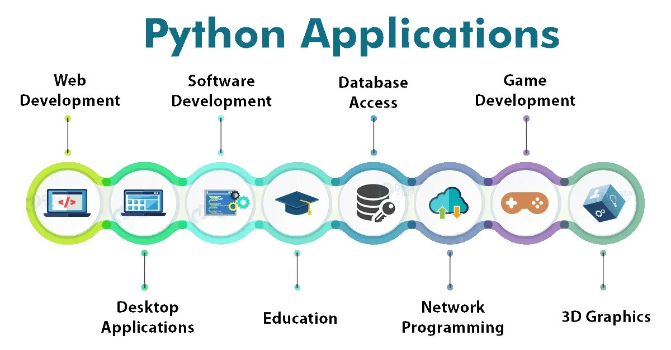

Slide 10
Python
Advantages:
Easy to learn
Easy to access libraries
Scientific community sharing
(open source, libraries)
Disadvantages:
Slow
Interpreted (dependencies)
Not typed (errors)
C++
Advantages:
Execution speed
Pre-Compiled
Typed
Modern Libraries and professional
Disadvantages:
Learning Curve
Harder to access libraries

Slide 11
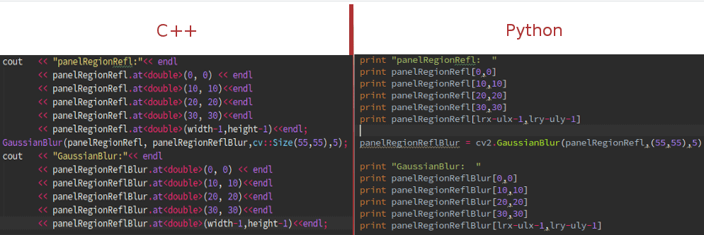

Slide 12
Types:
Integers ( …, -2, -1, 0, 1, 2, …)
Floats ( …, -2.0, -1.0, 0, 1.0, 2.0, …)
Doubles (same as floats but can represent larger numbers)
Boolean (True, False)
Strings (“I am a firefighter”)
Lists
Arrays
Stack
Heap
Queue
Trees
Maps
Graphs

Slide 13
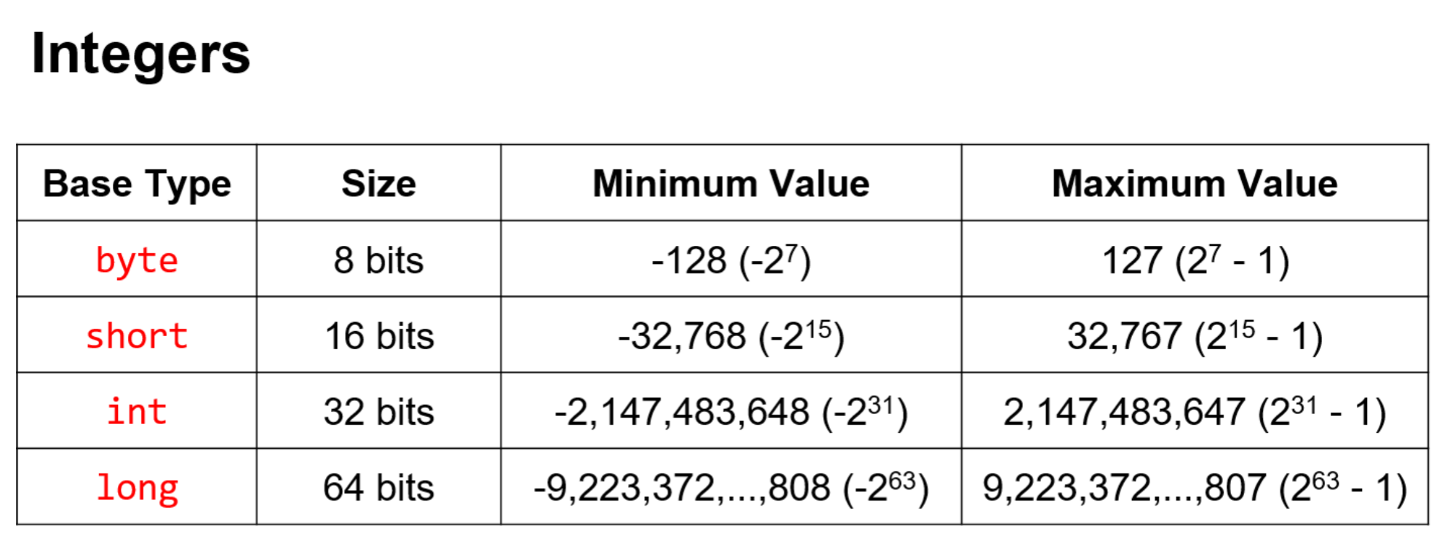

Slide 14
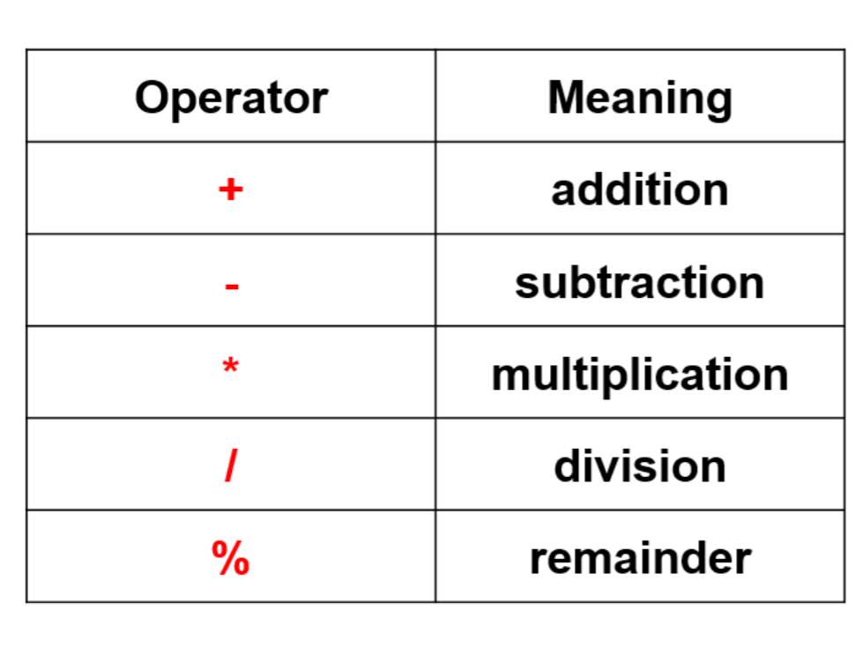

Slide 15
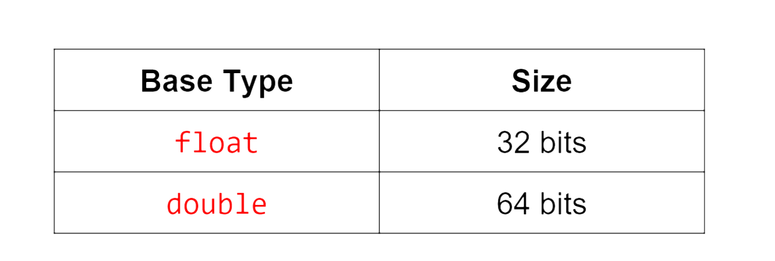
Floats

Slide 16
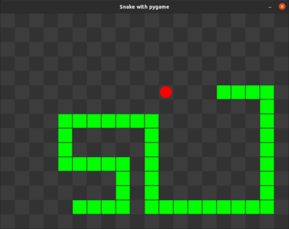
Object Oriented Programming

